Slide 1

Introduction to
Embedded and Robotics Programming
Cosmin Bonchis, Alin Brindusescu, Cristi Vladu
Notes:
*** Version of 2017 ***

Slide 2
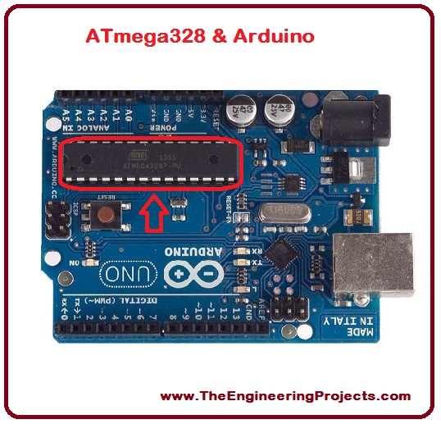
Introduction to Embedded and Robotics Programming
μC Architecture
Arduino UNO
  ATmega-328 micro-controller
  is Advanced Virtual RISC (AVR) micro-controller
  Data up to 8 bits
  32KB internal builtin memory.
  1KB EEPROM (Electrically Erasable Programmable
  Read Only Memory)
  2KB SRAM (Static Random Access Memory)
  Features:
    advanced RISC architecture
    good performance
    low power consumption
    real timer counter having separate oscillator
    6 PWM pins
    programmable serial USART
    programming lock for software security
© University of West & Elektrobit (EB) 2018
Notes:
Dielectric, dielectric polarization
Decoupling – filtering the power for unexpected, short interruption

Slide 3
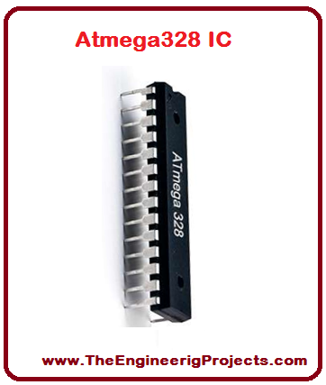
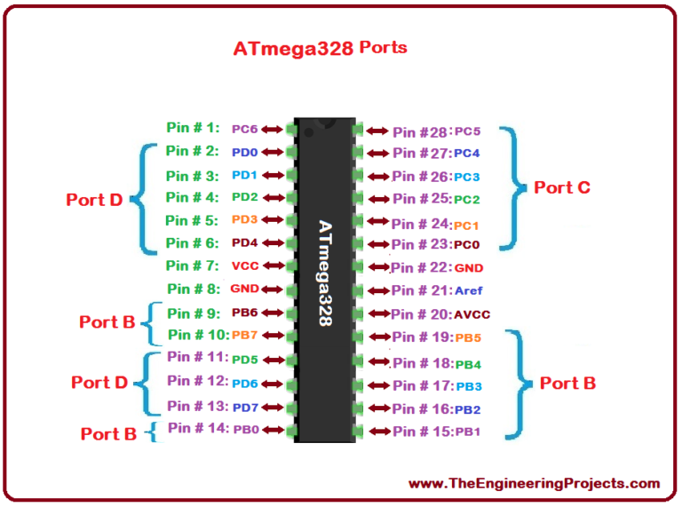
Introduction to Embedded and Robotics Programming
μC Architecture - ATmega328
28 pins
functions associated with the pins must be known in order to use the device appropriately
pins are divided into different ports
© University of West & Elektrobit (EB) 2018

Slide 4
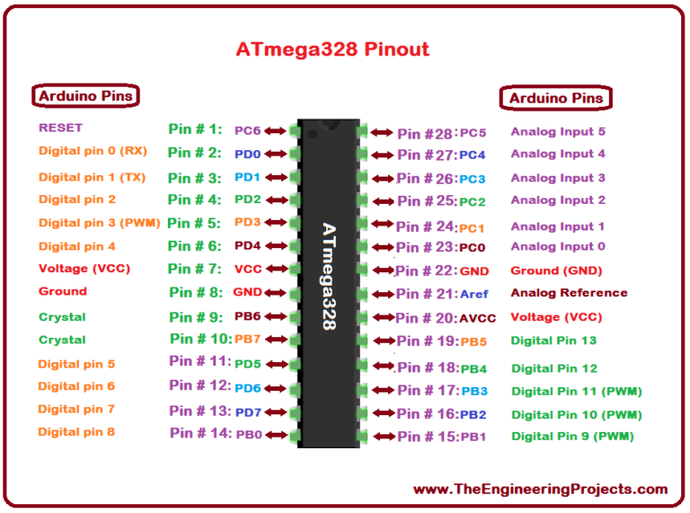
Introduction to Embedded and Robotics Programming
μC Architecture - Ports
VCC is a digital voltage supply.
AVCC is a supply voltage pin for analog to digital converter.
GND denotes Ground and it has a 0V.
Port B (PB0 to PB7). 8 bit bidirectional port
having an internal pull-up resistor.
Port C (PC0 to PC7). The output buffers
with symmetrical drive characteristics
Port (PD0 to PD7). 8 bit input/output port
having an internal pull-up resistor.
© University of West & Elektrobit (EB) 2018

Slide 5
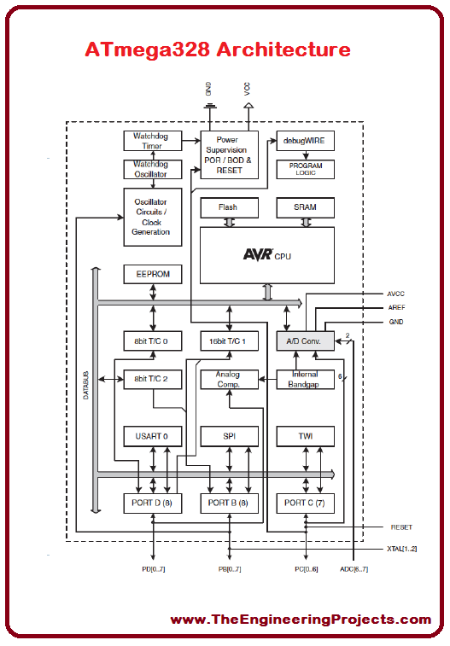
Introduction to Embedded and Robotics Programming
μC Architecture
An architecture of a device
presents each information
about the particular device.
© University of West & Elektrobit (EB) 2018
Notes:
A combination of a P-type and N-type semiconductor material (p-n junction)
Forward Bias – current flowing from Anode to Cathode if the + is connected to the anode and the minus to cathode
Reverse bias – conecting minus to anode
Zener diode allow the current to flow in the reverse direction at the Zener voltage
Schottky diode – very fast switching
Tunnel diode – very fast switching in the range of microwave frequency

Slide 6
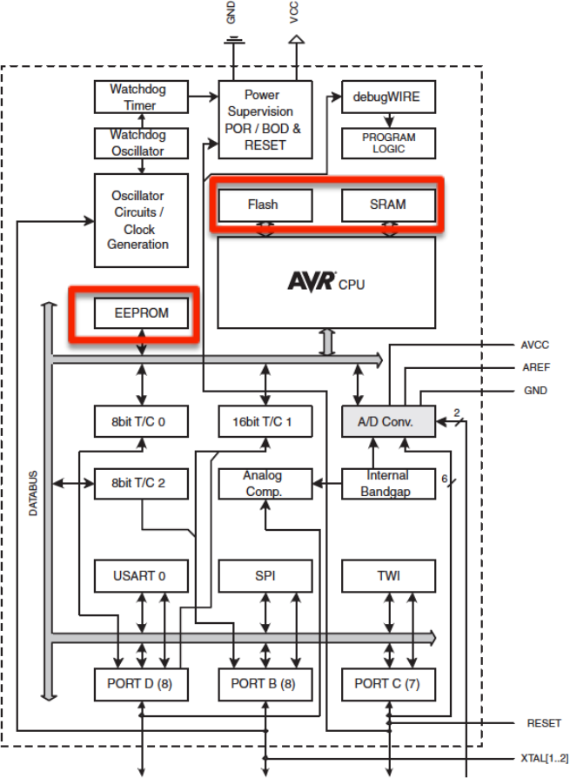
Introduction to Embedded and Robotics Programming
μC Architecture - Memory
Flash (32K) (15-bit addresses)
  Programmable Read Only Memory (ROM)
  Non-volatile
  Allocate data to Flash using
  PROGMEM keyword
SRAM (2K) Static Random Access Memory
  Temporary values, stack, etc.
  Volatile
  Limited space!
EEPROM (1K) Electrically Erasable Programmable
Read Only Memory.
  Long-term data
  see documentation
© University of West & Elektrobit (EB) 2018

Slide 7
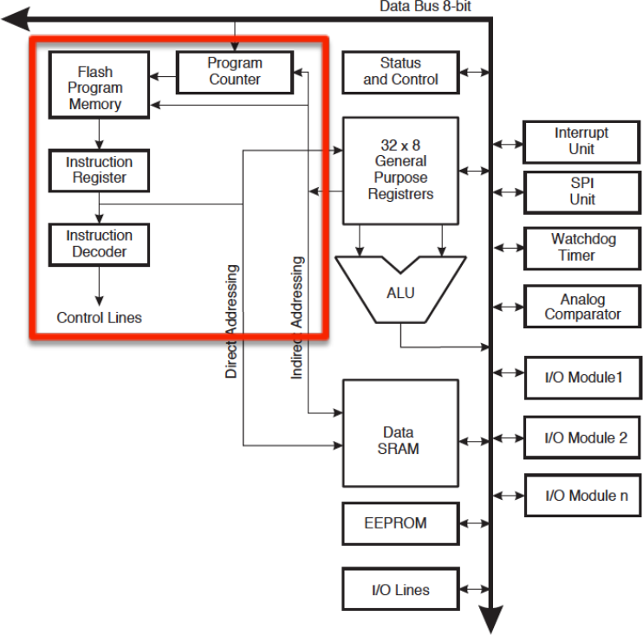
Introduction to Embedded and Robotics Programming
μC Architecture - CPU
Instruction Fetch
and Decode
© University of West & Elektrobit (EB) 2018

Slide 8
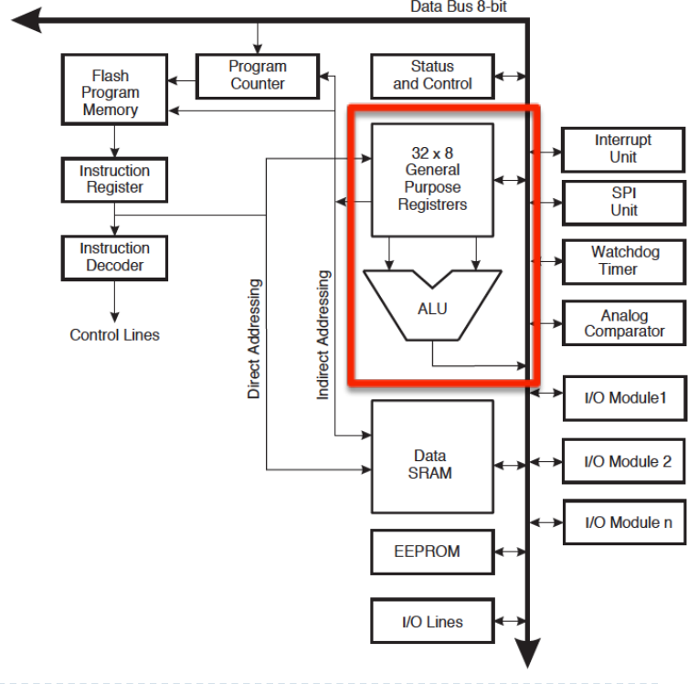
Introduction to Embedded and Robotics Programming
μC Architecture - CPU
ALU Instructions
© University of West & Elektrobit (EB) 2018
Notes:
The base acts like the controllable valve, controlling the flow of electrons from the emitter to the collector

Slide 9
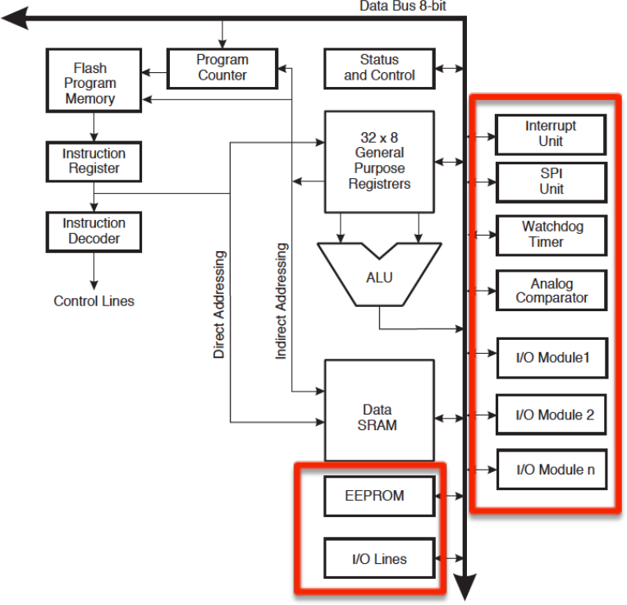
Introduction to Embedded and Robotics Programming
μC Architecture - CPU
I/O and special
functions
© University of West & Elektrobit (EB) 2018
Notes:
The base acts like the controllable valve, controlling the flow of electrons from the emitter to the collector

Slide 10
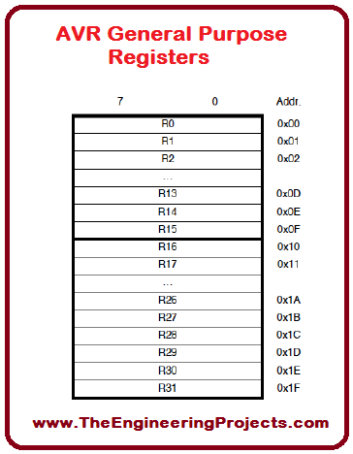
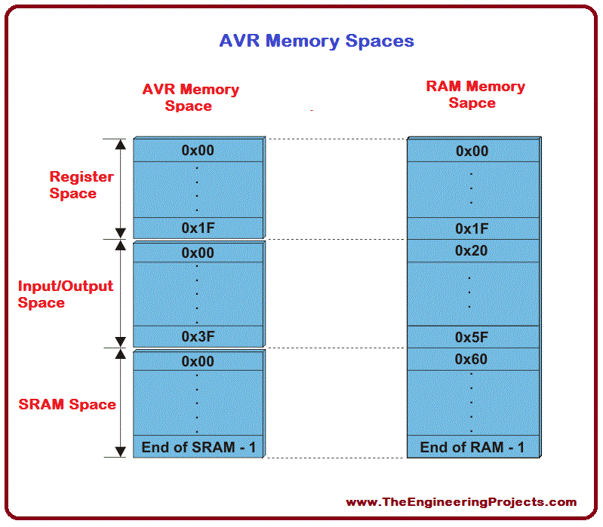
Introduction to Embedded and Robotics Programming
μC Architecture - Registers
32 General Purpose (GP) registers
All are from SRAM
© University of West & Elektrobit (EB) 2018
Notes:
The base acts like the controllable valve, controlling the flow of electrons from the emitter to the collector

Slide 11
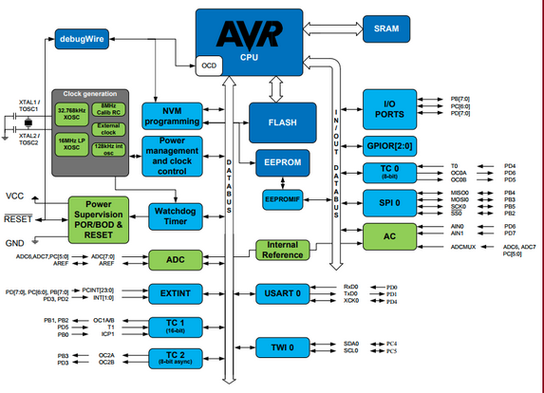
Introduction to Embedded and Robotics Programming
μC Architecture
Block diagram shows the internal circuit and the flow of the program
© University of West & Elektrobit (EB) 2018
Notes:
The base acts like the controllable valve, controlling the flow of electrons from the emitter to the collector

Slide 12
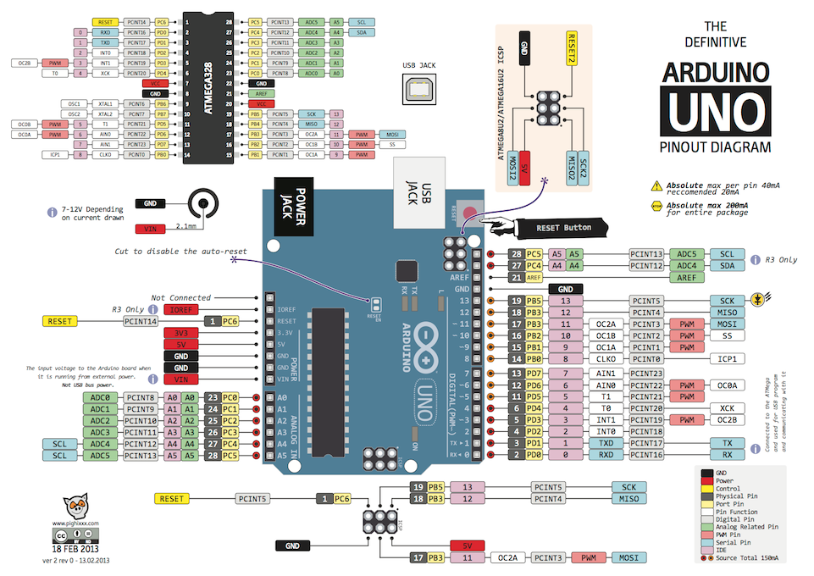
Introduction to Embedded and Robotics Programming
μC Architecture
© University of West & Elektrobit (EB) 2018
Notes:
Dielectric, dielectric polarization
Decoupling – filtering the power for unexpected, short interruption

Slide 13
Introduction to Embedded and Robotics Programming
μC Architecture
More to read:
  http://www.instructables.com/lesson/Capacitors-2/
  https://www.sciencebuddies.org/science-fair-projects/references/how-to-use-a-breadboard
  https://www.kitronik.co.uk/blog/led-resistor-value-calculator/
  https://learn.sparkfun.com/tutorials/diodes
  https://learn.sparkfun.com/tutorials/transistors
© University of West & Elektrobit (EB) 2018

Slide 14
Happy Hacking!
μC U next Week!
μC Architecture
Introduction to
Embedded and Robotics Programming
© University of West & Elektrobit (EB) 2018

